Slide 1
Wells Fargo’s GDPR Compliance
Presenter: Marko Jevtic, Aparna Kusalker, Estefania Lopez
Course Name: MSIS 672 - Data Architecture & Management
Professor Name: Professor Kourosh Dadgar
Notes:
Marko
Good Morning everyone, we are Group 3: Marko, Aparna, and Estefania.
And welcome to our presentation on Wells Fargo’s approach to GDPR compliance. Today, we will take a deep dive into how Wells Fargo, as one of the largest financial institutions in the world, has aligned its data management and governance practices with GDPR requirements. This includes examining their challenges, solutions, and the technologies used to address data privacy and compliance concerns. By the end of this presentation, you’ll have a comprehensive understanding of Wells Fargo’s efforts in ensuring customer trust and adhering to regulatory frameworks like GDPR

Slide 2
Table of Contents
Introduction to Wells Fargo
Mission, Vision, & Strategy
Executive Summary
GDPR Overview and Policy
Fishbone Diagram: Data Breach Incident
Shareholder Matrix Analysis
Event Response List
Data Flow Diagrams: Context Level, Level 0 and Level 1
CRUD Matrix
Risk Classification of Data
AWS S3 Data Storage and GDPR Compliance
Conclusion

Slide 3

Wells Fargo Overview
Wells Fargo, founded in 1852 by William Fargo and Henry Wells, is one of the largest U.S. banks, serving over 70 million clients worldwide. Its three core divisions—Consumer Banking, Wholesale Banking, and Wealth & Investment Management—focus on delivering customer value, operational efficiency, and community engagement. With a strong domestic and global presence, Wells Fargo continues to lead the financial services industry through innovation and commitment.
Notes:
Marko
Wells Fargo is a financial services giant founded in 1852 and headquartered in the United States. It serves over 70 million customers globally and operates through three primary divisions: Consumer Banking, Wholesale Banking, and Wealth and Investment Management. These divisions offer a range of financial products, including banking, loans, mortgages, and investment solutions. Wells Fargo’s global operations make it a critical player in the financial services sector, and its commitment to operational excellence has been instrumental in maintaining its strong presence in the industry. However, with such a vast customer base, ensuring data privacy and compliance with regulations like GDPR is a significant undertaking.

Slide 4
Mission, Vision, Strategy
Mission: To help customers achieve financial success by delivering excellent services and products, fostering long-term relationships, and supporting communities.
Vision: To be the most trusted financial services company, driven by responsible financing, customer focus, and effective financial innovation.
Strategy:
Enhance customer satisfaction.
Ensure strong compliance.
Leverage technology to protect customer data and improve services.
Notes:
Marko
Wells Fargo’s mission is simple yet impactful: to help customers succeed financially. This mission reflects their dedication to supporting individuals, businesses, and communities in achieving their financial goals. Their vision is to be recognized as the most trusted financial services company, emphasizing a culture of responsible banking and customer-first innovation. To achieve this, Wells Fargo employs strategies that focus on enhancing customer satisfaction, ensuring compliance with regulatory requirements, and leveraging technology to secure customer data. These strategies align with their operational goals and the broader regulatory frameworks like GDPR, which is integral to safeguarding customer trust

Slide 5
Executive Summary
GDPR Compliance at Wells Fargo
Progress: Established a robust data governance and privacy strategy aligned with GDPR principles, emphasizing transparency, purpose limitation, and data accuracy.
Security: Deployed advanced measures like encryption, access controls, and audits to safeguard personal data.
Customer Rights: Ensures rights to access, correct, erase, and restrict data through transparent data management mechanisms.
Challenges:
Employee training gaps and high sales pressure.
Outdated technology and ineffective audits led to past breaches.
Notes:
Marko
To summarize, this presentation highlights Wells Fargo’s comprehensive efforts to comply with GDPR regulations. As a global financial institution handling vast amounts of sensitive data, Wells Fargo faces unique challenges in aligning its systems and processes with GDPR.
Their current ecosystem, though fully compliant, requires enhancements in transparency, real-time monitoring, and cross-border data governance to keep being compliant.
We observed how Wells Fargo would benefit from adopting advanced tools like AWS S3, Amazon Macie, CloudTrail, and GuardDuty to strengthen data security, automate governance, and ensure compliance. These solutions provide scalable, centralized storage, sensitive data detection, and threat monitoring, aligning perfectly with GDPR’s core principles of transparency, accountability, and security.

Slide 6
continued …
Solutions:
Enhance employee training programs.
Upgrade legacy systems.
Conduct more frequent audits to strengthen compliance.
Stakeholders & Tools:
Legal, Compliance, IT, and Data Security teams, supported by C-suite leadership.
Analysis tools like DFDs, Risk Classification, and CRUD Matrices identify compliance touchpoints and areas for improvement.
Notes:
Key recommendations include continued modernization of legacy systems, enhanced employee training and satisfaction, and the expansion of automated tools for governance. With these measures, Wells Fargo is well-positioned to maintain its leadership as a trusted financial institution while navigating the complexities of GDPR compliance.

Slide 7
GDPR Compliance at Wells Fargo
Commitment to Privacy:
Adheres to strict privacy standards, transparency, and robust security measures.
Key Policy Highlights:
Information Collection: Personal, financial, and interaction data for personalized services.
Information Use: Maintains accounts, processes transactions, prevents fraud, and ensures compliance.
Data Sharing: Collaborates with affiliates and third parties under strict privacy standards.
Notes:
Marko
Wells Fargo is very serious about data privacy and compliance with the GDPR through some pretty comprehensive policies and industry best practices: strict standards of privacy, transparency to customers, and strong security measures.
Key Elements of Wells Fargo's Privacy, Cookies, and Security Policy:
Information Collection: Wells Fargo may collect personal information to deliver personalized services. Examples of personal data include personally identifiable information, financial information, and interaction information.
Information Use: Wells Fargo shares personal information for the maintenance of customer accounts, the processing of transactions, or for enhancing services offered. Such information is also used to prevent fraud and to ensure that the organization complies with all the necessary regulations.
Data Sharing: Wells Fargo shares personal information with its affiliates and third-party service providers for the conduct of appropriate business or otherwise in accordance with applicable laws and regulations. The bank ensures all third parties meet rigorous privacy standards.

Slide 8
continued …
GDPR Compliance:
Ensures access, correction, deletion, and data portability rights for EU customers.
Security Measures:
Employs encryption, access controls, and continuous monitoring to protect data.
Transparency:
Provides clear privacy notices and opt-out options for data processing.
Notes:
Marko
GDPR Compliance: Wells Fargo follows GDPR for enhanced privacy rights pertaining to access, correction, deletion, restriction of processing, or portability of data if any of its customers are within the EU.
Security Measures: Wells Fargo deploys appropriate security measures to protect customer information by using encryption, access controls, and monitoring on an ongoing basis to detect and address potential vulnerabilities.
Transparency: Wells Fargo continues to promote transparency through privacy notices which it provided to its customers, including opt-out opportunities for various types of data processing and communications.
now aparna will tell you a bit more about the accident that happened about the data breach and estefania will later take on the analysis we did

Slide 9
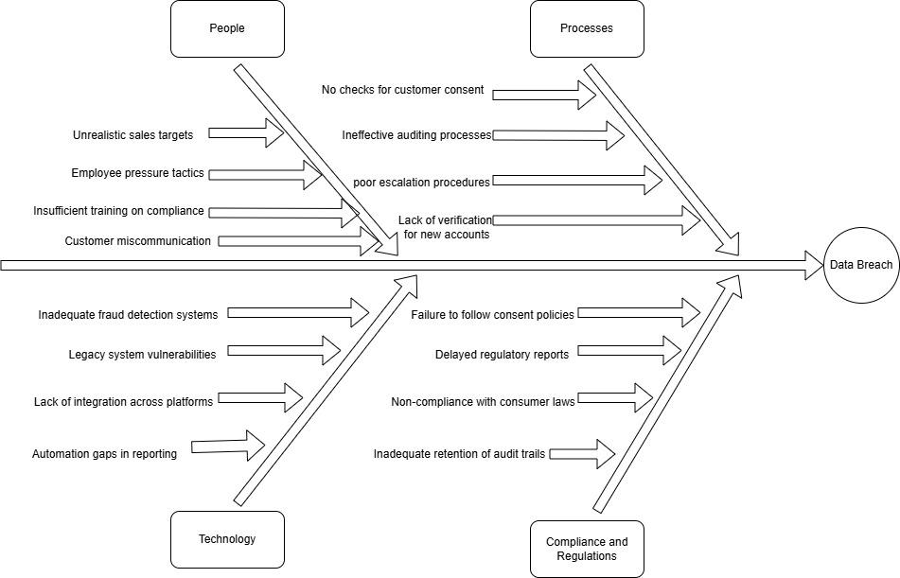
Fishbone Diagram
Notes:
Aparna :There was an incident that took place in Wells Fargo on December 31st 2021, wherein one of the employees emailed files containing sensitive information such as social security numbers as well as private information such as first name, last names, mailing addresses, date of birth of its customers. Wells Fargo reported it to the state Attorney General’s office, on May, 2022, over four months after the data breach occurred.
After a thorough root cause analysis of the incident it was noted that it occurred because of the 4 major factors:
People:
High sales targets tends the employees to give more priority to the performance and not the compliance
When employees are under pressure then they tend to get engaged in unethical practices rather than compliance
Employees does not have enough knowledge to recognize and prevent the risks due to insufficient training.
Communication gap among the customer and the employees lead to customers sharing PII data or sensitive information with the third parties leading to data leakage.
Processes:
Customer Consent: It's essential to always obtain customer consent before sharing data or initiating transactions. Without it, we risk data breaches and losing customer trust.
Auditing Practices: Regular and effective audits are crucial. Infrequent or weak audits can overlook vulnerabilities or fail to detect unauthorized access in time.
Issue Escalation: Clear and timely escalation processes are a must. Delays or confusion can leave breaches unresolved or even unnoticed, exacerbating the problem.
Verification Systems: Robust verification systems are non-negotiable. Weak systems increase the chances of fraudulent accounts or unauthorized access, putting sensitive data at risk.
Technology:
Weak fraud detection systems leave vulnerabilities wide open for exploitation.
Outdated systems often lack modern security features, making them more susceptible to intrusions.
Platforms that are inconsistent or not well-integrated can create data silos, opening up security gaps.
Relying on manual methods for breach tracking and reporting is slower and less reliable, increasing risks.
Compliance and Regulations:
Failing to follow consent rules can result in unauthorized data usage and potential breaches, which undermine trust.
Delays in reporting not only risk fines for non-compliance but also slow down breach mitigation, worsening the impact.
Violating consumer protection laws can lead to hefty fines and, more importantly, a significant loss of customer confidence.
Lastly, poor record-keeping makes it difficult to track access or pinpoint the cause of a breach, complicating resolution efforts.
These incidents highlight the importance of Wells Fargo demonstrating a strong commitment to data security. It’s crucial for the company to take proactive, effective, and up-to-date steps to protect the personal data it stores and processes, ensuring customers can trust their information is safe.

Slide 10
Shareholder Matrix
Stakeholders include both internal and external groups.
Focus is on key stakeholders directly impacted by GDPR regulations and Wells Fargo’s personal data management practices.
Internal Stakeholders | External Stakeholders
Legal & Compliance IT & Data Security C-Suite & Board of Directors Employees | Customers GDPR Regulators Vendor & Third-Party Processors Shareholders & Investors Media
Notes:
Estefania
Thank you Aparna. Now that we've looked into the root causes of the 2021 incident, let’s transition into understanding who is involved and impacted. This stakeholder matrix help us prioritize and address the needs of key stakeholders as we develop our solution and perform our GDPR analysis.
As seen here, we divided stakeholders into internal and external:
Starting off with our Internal Stakeholders we have:
Legal and compliance: they make sure that Wells Fargo is in compliance with GDPR policies, processes and systems. Making their impact critical because they are directly responsible for ensuring that compliance is met.
Next is
IT and Data Security: they manage the various systems that store and process personal data. Making their impact critical because they are responsible for system implementation of compliance.
C-Suite and Board of Directors: they lead Wells Fargo’s overall strategy and performance and are responsible for all big decisions. Their impact is also critical because not having their decisions align with regulations, can have Well Fargo face massive penalties.
And finally we have
Employees: they directly handle customer financial and personal data daily. Making their impact high due to the risk of exposing sensitive data.
Next we move onto External Stakeholder:
Customers: they are the ones using Wells Fargo’s services and allowing use of their data. Making their impact critical because any misuse of their data can lead to lawsuits and mistrust, which can result in reputable damage to the company.
Next are
GDPR Regulators: This stakeholder oversees Wells Fargo’s behavior in relation to GDPR and enforces compliance and penalizing if necessary. Their impact is critical because any noncompliance will lead to significant penalties, legal and reputational consequences.
Vendors and Third-Party Processors: they are responsible for processing data through cloud providers and fintech partners like Stripe or Mastercard. Making their impact critical because their noncompliance can also lead to penalties.
Finally we have
Shareholders and Investors: These stakeholder owns Wells Fargo stock and are directly tied to their financial success. Making their impact high because any compliance risks can lead to investors pulling out of the company and resulting in major financial consequences.

Slide 11
Event Response List
Account Management:
Trigger: Customer updates account information.
Response: Validate inputs, save changes, notify customer.
Money Transfer (e.g., Zelle):
Trigger: Customer initiates a transfer.
Response: Verify recipient and compliance, execute transfer, send confirmation.
Check Orders by Bankers:
Trigger: Banker requests customer information for checks.
Response: Access data securely, process order.
Notes:
Estefania
Now that we have a clear understanding of our key stakeholders, their priorities and impact, we move on to our Event Response List. This lays foundation to our DFD’s.
First up we have a
1. Customer who Wishes to Manage their Online Account info:
this
Triggers: The customer updating their account details, for example their address or phone number.
and having a
Response: of The system validating the new information, ensuring it meets formatting and security requirements. Once validated, the changes are saved in the customer database, and the customer receives a notification confirming this update. As a result ensuring transparency, a core GDPR principle.
—-------------------------
2. Customer who Sends Money via Zelle:
this
Triggers: The initiation of a money transfer to an external banking account through Zelle.
the
Response: being the system verifying the recipient’s account and ensuring the transaction complies with financial regulations. Once the compliance check is complete, money is transferred, and the customer receives a confirmation notification.
Third. we have a Banker who Supports a Customer with Ordering New Checks:
this
Triggers: A banker retrieves customer account information to process a request for new checks.
and the
Response: The system grants the banker secure access to the customer’s data, ensuring that this access is logged for auditing purposes. After the order is processed, the customer receives confirmation, maintaining transparency and accountability.

Slide 12
continued …
Purchase Monitoring:
Trigger: Online purchase initiated.
Response: Monitor transaction, alert for anomalies, generate reports for regulators.
Payment Authorization:
Trigger: Customer completes a payment.
Response: Third-party authorization, confirm success or failure.
Credit Score Requests:
Trigger: Customer submits a credit score inquiry.
Response: Verify data accuracy, provide score, log request.
Notes:
Estefania
4. Customer Completes an Online Purchase:
Trigger: The customer initiates a purchase through Wells Fargo’s online platform.
Response: The system monitors the transaction for compliance with internal policies and GDPR requirements. If any anomalies or suspicious activities are detected, alerts are generated for further review. Additionally, reports are created for regulatory purposes to ensure accountability.
5. Customer Completes Payment Authorization:
Trigger: A customer authorizes a payment through a third-party vendor or service provider.
Response: The third-party system validates the authorization request and processes the payment. Depending on the result, the customer is notified whether the payment was successful or denied. This ensures that the data flow between Wells Fargo and third parties remains secure and GDPR-compliant.
And our final event
6. Customer Seeks Credit Score Information:
Trigger: The customer submits a request to retrieve their credit score.
Response: A third-party service receives the request, verifies the data’s accuracy, and presents the credit score to the customer. The system logs this request to ensure transparency and accountability in compliance with GDPR principles.
We selected these events while keeping GDPR principles in mind and how Wells Fargo is ensuring that every interaction is secure and compliant.

Slide 13
Data Flow Diagram (DFD’s)
Purpose: Visualize how data flows through a system, including inputs, outputs, processes, and storage.
Levels:
Context Level: High-level overview of the system.
Main stakeholders: Customers, Employees, Vendor & Third-Party Processors, GDPR Regulators
Level 0: Detailed view of major processes.
Key processes: Account Management, Payment processing, Customer notifications, Payment dispute, Transaction update
Level 1: Granular breakdown of data movement.
Main focus on the process of payment processing
Importance: Ensures clarity, identifies dependencies, and highlights areas to improve compliance and efficiency.
Notes:
Estefania
Having discussed our event response list, our next step is to understand how data moves through the system to support these actions with Data Flow Diagrams, or DFDs.
Up next we’ll look at DFD’s at different levels to visualize the flow of data and identify important interactions.
First at the context level, with a high-level overview of the system that includes select stakeholders
Next we’ll have Level 0 that breaks down major processes such as account management, payment processing, and customer notifications.
And finally, we’ll look at Level 1 that provides a detailed view of specific processes, like payment authorization.
All these DFD’s are important in order to identify potential vulnerabilities and ensuring compliance with GDPR requirements.

Slide 14
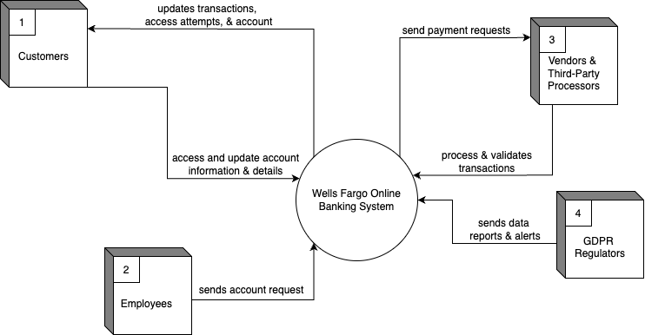
Context Level
Notes:
Estefania
Here we have the Context Level through a high-level lens, showing the systems as a single process and how it interacts with stakeholders. Here we’ve decided to focus on select main stakeholders - Customers, Employees, Vendors & Third Party Processors, and GDPR Regulators. We’ll start off with 1. Customers and how they provide their personal and financial data (e.g. account details, transactions), in return they receive account updates, notifications, and transactions confirmations from the system.
Next 2. we have Employees who send account requests to the system in order to manage all customer interactions, provide customer support, and monitor transactions.
Third. Vendor & Third-Party Processors interact with the system in order to handle payment processing or additional services. This data includes transaction details, system updates, and service logs.
And lastly, we have 4. GDPR Regulators who oversee compliance by generating system reports and audit logs in order to have WF keep with data protection regulations.
Marko will be covering our Level 0 in the next slide

Slide 15
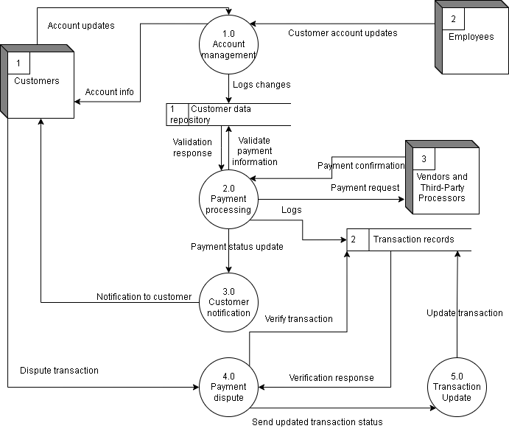
Level 0
Notes:
Marko
Level 0 highlights major processes, data flows, and data stores within the system, including both internal and external stakeholders. It starts with customers and employees interacting the the account management process to create/update/delete account information. This data is stored in the customer data repository. After that the payment processing process is requesting verification of data from the customer data repository, and then it interacts with vendors and third-party processors for payment requests and authorization. Payment statuses are logged in the transaction records, and updates are sent through the customer notification process to the customer. If there are any disputes, the payment dispute process handles the issue, making sure updates are reflected in the transaction records via the transaction updates process to maintain accuracy and compliance.

Slide 16
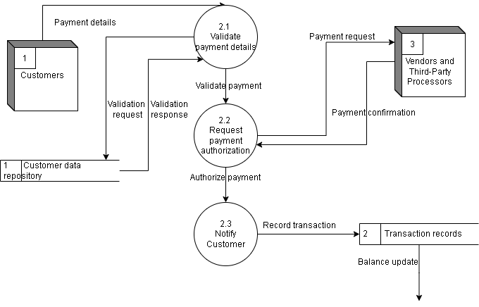
Level 1
Notes:
Aparna
Lastly, Level 1 dives into much more detailed sub-processes, zooming into specific data interactions. The process we are focusing on is the payment processing process. The customer provides payment details, which are validated through the validate payment details process using the customer data repository. Once validated, the request payment authorization process sends payment requests to vendors and third-party processors for authorization. After receiving the payment confirmation the notify customer process updates the customer about the transaction and records the details in the transaction records database. The transaction records database ensures real-time updates to account balances while maintaining accuracy and compliance.

Slide 17
CRUD Matrix
User Onboarding Process:
Personal Data (CRUD)
Authentication Data (CRUD)
Consent Data (CD)
Account Management Process:
Personal information (RUD)
Consent Data (RUD)
Data Audit Logs (RD)
Personalized Recommendation Generation:
Personal Data (R)
Behavioral Data (CRU
Data Audit Logs (R)
Loan Origination Process:
Personal Data (CRUD)
Authentication Data (CRUD)
Consent data (CD)
Transactional Data (CRUD)
Online Payment Processing:
Personal Data (CRD)
Authentication Data (CRUD)
Transactional Data (CRUD)
Fraud Detection and Alert System:
Behavioral Data (CRU)
Transactional Data (CRU)
Data Audit Logs (CRUD)
Customer Support and Query Management:
Personal Data (CR)
Data Audit Logs (CRUD)
Card Issuance and Replacement:
Personal Information (CRD)
Authentication Data (CRD)
Consent Data (CD)
Transactional Data (CRU)
Recurring Payments Management:
Personal Information (RUD)
Transactional Data (CRU)
Mobile App Login and Authentication:
Authentication Data (CRU)
Data Audit Logs(RD)
Notes:
Aparna - CRUD matrix - I will go through the most important ones
User Onboarding Process: this process Includes gathering customer data for account creation and verification of credentials.
Personal Data (CRUD): Customer name, address, phone number, and identifications are created upon onboarding; read for verification, updating in case of any corrections that have to be made, deleting upon users' needs.
Authentication Data (CRUD): Login credentials are created, updated upon password reset, and deleted upon account closure.
Consent Data (CD): Data is collected, created about explicit consent for the use which eventually can also be deleted by a customer.
Account Management Process: this is the process where the customer will be able to update and manage his own account details.
Personal information (RUD): reading of customer information and update or delete upon address by the customer for closure.
Consent Data (RUD): The consumer would be able to update or withdraw consent regarding marketing or data sharing.
Data Audit Logs (RD): Changes to accounts can be logged to be read for auditing purpose. And the logs then get deleted when retention policies expire.
Personalized Recommendation Generation: Uses customer behavioral data to provide personalized product and service recommendations.
Personal Data (R): It shows which user each recommendation belongs to.
Behavioral Data (CRU): Behavioral patterns created with the tracking of user interactions are updated over time when preferences change, while reads occur when generating recommendations.
Data Audit Logs (R): Logs would be read to validate the compliance to the privacy standards.
Loan Origination Process:Responsible for the processing of loan applications, including credit, approval, and compliance concerns.
Personal Data (CRUD): The applicants will provide personal information for processing, which is read for verification purposes, updated along the processing pipeline, and deleted upon withdrawal or when applications become obsolete.
Authentication Data (CRUD): Authentication is required to secure application processing.
Consent data (CD): Explicit consent is taken for credit check data and shared with third-party agencies.
Transactional Data (CRUD):Loan disbursement and repayment data are read for reconciliation, updated in case of correction, and deleted when retention policies allow for this.
Mortgage Application and Processing: Handles customer mortgage applications, from initiation to approval.
CRUD Matrix:
Similar to the Loan Origination Process, due to its handling of sensitive data.
Online Payment Processing: Electronic funds transfers, bill payment service, and compliance verification.
Personal Data (CRD): From about the recipient's information and user input required to make a payment - Read to process, delete on request from a user.
Authentication Data (CRUD): Payment authorization will need secure login credentials.
Transactional Data (CRUD): Payments are created as records, updated when there are errors, read for statements, and after retention deleted.
Fraud Detection and Alert System: Monitors transaction for suspicious activities and generates alerts.
Behavioral Data (CRU): Create pattern ability for anomaly detection that is dynamic; read for transaction validation.
Transactional Data (CRU): Transactions are monitored, updated for corrections, and stored for compliance.
Data Audit Logs (CRUD): Logs generated by the detection activities of events are read to review them and deleted post-retention.
Customer Support and Query Management:Answers customer inquiries, resolves customer complaints.
Personal Data (CR): Support agents access customer data to resolve issues.
Data Audit Logs (CRUD): All activities are logged for auditing purposes.
Card Issuance and Replacement: Issues new cards or replaces lost/damaged cards.
Personal Information (CRD): Collected upon joining, updated based on address changes, and deleted when the card is invalidating.
Authentication Data (CRD): Allows the secure enabling and disabling of the card.
Consent Data (CD): Required for issuing personalized cards.
Transactional Data (CRU): card records for reporting purposes and fraud detection.
Recurring Payments Management: Manages payments that are scheduled for customers.
Personal Information (RUD) - Read: In order to validate customer identity; Update: When changed; Delete: When terminated.
Transactional Data (CRU): -records payment schedules, updates regarding changes, and executes on time.
Mobile App Login and Authentication:To enable secure login and account access through mobile applications.
Authentication Data (CRU): The credentials are created, read for login validations, and updated for resets.
Data Audit Logs(RD): tracking login activities for security reasons.

Slide 18
Risk Classification of Data
Entity | Data Fields | CRD | HRD | MRD
Customer | Name |  |  | x
 | username & password | x
 | Address |  |  | x
 | Contact number |  |  | x
 | Email address |  |  | x
 | Card details - card number | x
 | Card details - expiration date |  | x
 | Bank account details (acc. no., routing no.) | x
Notes:
Aparna
:- Customer
Username and Password
x
Critical for account security; upon exposure, it may result in fraud and unauthorized access.
Critical for financial fraud; must be protected in accordance with PCI-DSS.
Supports card fraud if coupled with other sensitive details.
Bank account details (acc. no., routing no.)
x
Critical for fraudulent and unauthorized transactions.

Slide 19
continued …
Entity | Data Fields | CRD | HRD | MRD
Employees | Full name |  |  | x
 | Social Security Number (SSN) | x
 | Login credentials | x
 | Salary information |  | x
 | Address |  |  | x
 | Employment history |  |  | x
Notes:
Aparna
Employees
SSN
x
Critical for identity theft; exposure may result in severe impact.
Login credentials
x
Critical for system and data security; exposure may provide internal breach

Slide 20
continued …
Entity | Data Fields | CRD | HRD | MRD
GDPR Regulators | Personal Identifiable Information (PII) | x
 | Consent documentation |  | x
 | Data processing records |  | x
 | Right to access data requests |  |  | x
Notes:
Aparna
: GDPR Regulators
Personal Identifiable Information (PII)
x
Critical under GDPR; exposure leads to penalties and reputational damage.

Slide 21
AWS S3 and GDPR Compliance at Wells Fargo
Centralized storage:
Consolidates data into one repository, simplifying compliance
Handles structured (customer data) and unstructured (logs) data
Scalability:
Supports virtually unlimited storage, meeting Wells Fargo’s global needs
GDPR Alignment:
Reduces fragmentation and ensures data is accessible only for legitimate purposes
Notes:
Marko
Let’s start by looking at AWS S3 and how it supports GDPR compliance for Wells Fargo.
AWS S3 provides centralized storage, which is a game-changer for managing data. By grouping all data into a single repository, Wells Fargo can reduce fragmentation, simplifying compliance efforts and ensuring that data is consistently governed. This centralization makes it easier to locate, classify, and monitor data, especially when handling both structured customer data and unstructured logs.
Scalability is another critical feature of AWS S3. With virtually unlimited storage capacity, Wells Fargo can confidently handle its massive volume of global customer data. This scalability ensures that the bank is equipped to meet the demands of an ever-growing customer base without compromising performance or compliance.
From a GDPR perspective, AWS S3 aligns perfectly by ensuring data is accessible only for legitimate purposes. This reduces the risk of non-compliance and enhances trust with customers and regulators, as it supports GDPR’s principles of purpose limitation and accountability.

Slide 22
Data Privacy with Amazon Macie and Encryption
Amazon Macie:
Automates sensitive data detection in S3 buckets.
Flags unencrypted or publicly accessible data.
Supports GDPR principles like transparency and accountability.
Encryption Options:
Client-Side: Wells Fargo encrypts data before uploading, maintaining key control.
Server-Side: AWS encrypts and manages keys, simplifying security.
Benefit:
Protects personal data from unauthorized access, meeting GDPR’s integrity principle.
Notes:
Marko
Now let’s explore how Amazon Macie and AWS encryption options enhance data privacy for Wells Fargo.
While Macie operates independently Amazon Macie automates the detection of sensitive data within S3 buckets. For Wells Fargo, this means proactively identifying and flagging personal data, such as customer financial information, that may be at risk. Macie also flags unencrypted or publicly accessible data, helping Wells Fargo address potential problems before they become compliance issues. By supporting GDPR principles like transparency and accountability, Macie would ensure that Wells Fargo can demonstrate control over its data ecosystem to regulators.
Encryption plays a pivotal role here. With client-side encryption, Wells Fargo retains full control over encryption keys, ensuring data is secure before it’s even uploaded to the cloud. Server-side encryption simplifies key management by allowing AWS to handle it while maintaining robust security protocols. Both approaches protect customer data from unauthorized access, ensuring compliance with GDPR’s integrity and confidentiality principles.
Overall, these tools reduce the risk of data breaches, protect customer privacy, and reinforce Wells Fargo’s reputation as a trusted financial institution.

Slide 23
Security and Compliance with AWS Tools
AWS CloudTrail:
Logs API calls and user actions for auditable records.
Enables real-time alerts for suspicious activities.
Amazon GuardDuty:
Monitors threats using logs and machine learning.
Identifies risks like compromised credentials or data breaches.
Integration:
Interoperates with governance tools for centralized compliance management.
Outcome:
Ensures Wells Fargo’s systems stay GDPR-compliant and secure.
Notes:
Marko
Finally, let’s look at how AWS tools like CloudTrail and GuardDuty strengthen security and compliance for Wells Fargo.
AWS CloudTrail provides comprehensive logging of all API calls and user actions within the system. This creates an auditable record that allows Wells Fargo to monitor how data is accessed and used, ensuring compliance with GDPR’s accountability requirements. The real-time alerts offered by CloudTrail are invaluable for detecting suspicious activities, allowing the bank to respond swiftly to potential threats.
Amazon GuardDuty adds another layer of security by continuously monitoring for threats using machine learning and analyzing logs and flow of data. It can identify risks such as compromised credentials, helping Wells Fargo stay ahead of evolving cyber threats.
What makes these tools even more impactful is their ability to integrate with broader governance frameworks.
The outcome is clear: with these AWS tools, Wells Fargo would gain enhanced visibility, proactive threat management, and the ability to maintain GDPR compliance seamlessly, ultimately securing customer trust and mitigating regulatory risks.

Slide 24
Conclusion
Wells Fargo ensures GDPR compliance through aligned policies, processes, and technologies.
Secures data with encryption, real-time governance, and fraud detection.
Focuses on employee training, process upgrades, and system modernization.
Manages personal and transactional data with structured, GDPR-compliant practices.
Proactive measures reinforce its reputation as a trusted financial institution.
Notes:
Estefania
Thank you Marko. As seen in our presentation today, Wells Fargo demonstrated its commitment to GDPR compliance through its policies, processes, and technology investments. And how they’ve built a strong framework for customers data protection and governance.
We covered what they would gain by leveraging tools like AWS S3, Macie, and GuardDuty.
And in conclusion through, constant improvement in training, technology, and governance, they are on track with maintaining their customers trust and navigating an evolving regulatory environment.

Slide 25
Any questions or comments?
Thank you for your time and attention!
Notes:
Thank you for your time and attention. We hope our presentation has provided you all with insights into Wells Fargo’s approach to GDPR compliance. Please let us know if you have any questions.
strengthening its compliance and ethics programs, improving its customer service and communication practices, and increasing transparency and accountability within the company.

